Slide 1
Day 2
Aim: To review Divine Right of Kings and in particular why Great Britain seemed to not have to deal with absolute monarchy for as long as other European nations did.
Do Now: Impress me and make your Global I teacher look good.
The Magna Carta: Where (what nation) was it written? When was it written? Why was it written? What was its impact?

Slide 2
What and Where
The Magna Carta was signed in June 1215 between the barons of Medieval England and King John. 'Magna Carta' is Latin and means “Great Charter”.

Slide 3
Impact
Perhaps the Magna Carta's main contribution to democracy was that it was the first document in English history to limit the power of the monarch.

Slide 4
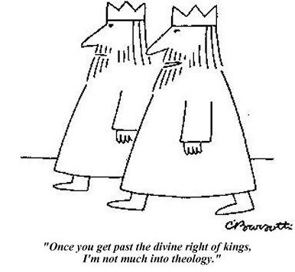
Analyze the cartoon to the left... to do so, you'll have to remember what "theology" is. Once you've done that, you'll have to recall what the "Divine Right of Kings" was. Next you'll have to... well, analyze the cartoon.
.

Slide 5
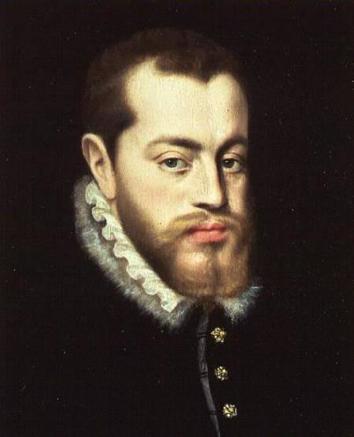
Philip II
A fierce defender of Catholicism fought battles against the Ottoman Muslims and Protestant British (under Elizabeth I... who defeated him). He also spent a ton of money on the arts and literature.

Slide 6
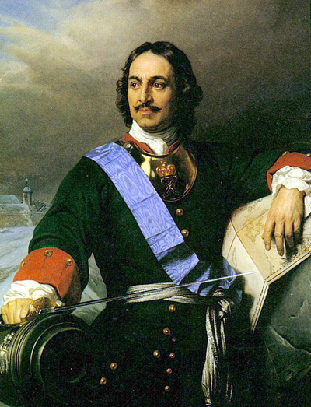
Czar Peter the Great 1682-1721
Main objective was the indoctrination of western ideals and modernization in Russia by going abroad in 1696
Traveled around Russia to learn more about technology and ways of industry
Increased the power of the Czar so he could implement his new reforms
Decreased the power of the nobles and placed the Roman Catholic church under his control
Promoted education and brought new advances to Russia such as newspapers, womens rights, and western clothing

Slide 7
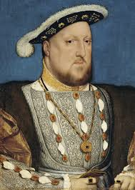
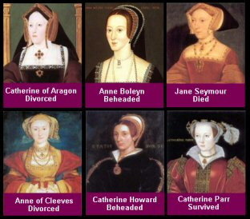
Henry VIII of England claimed divine right when he had the Act of Supremacy passed and it claimed him to be the head of the Church of England. He also did some other terrible things...

Slide 8
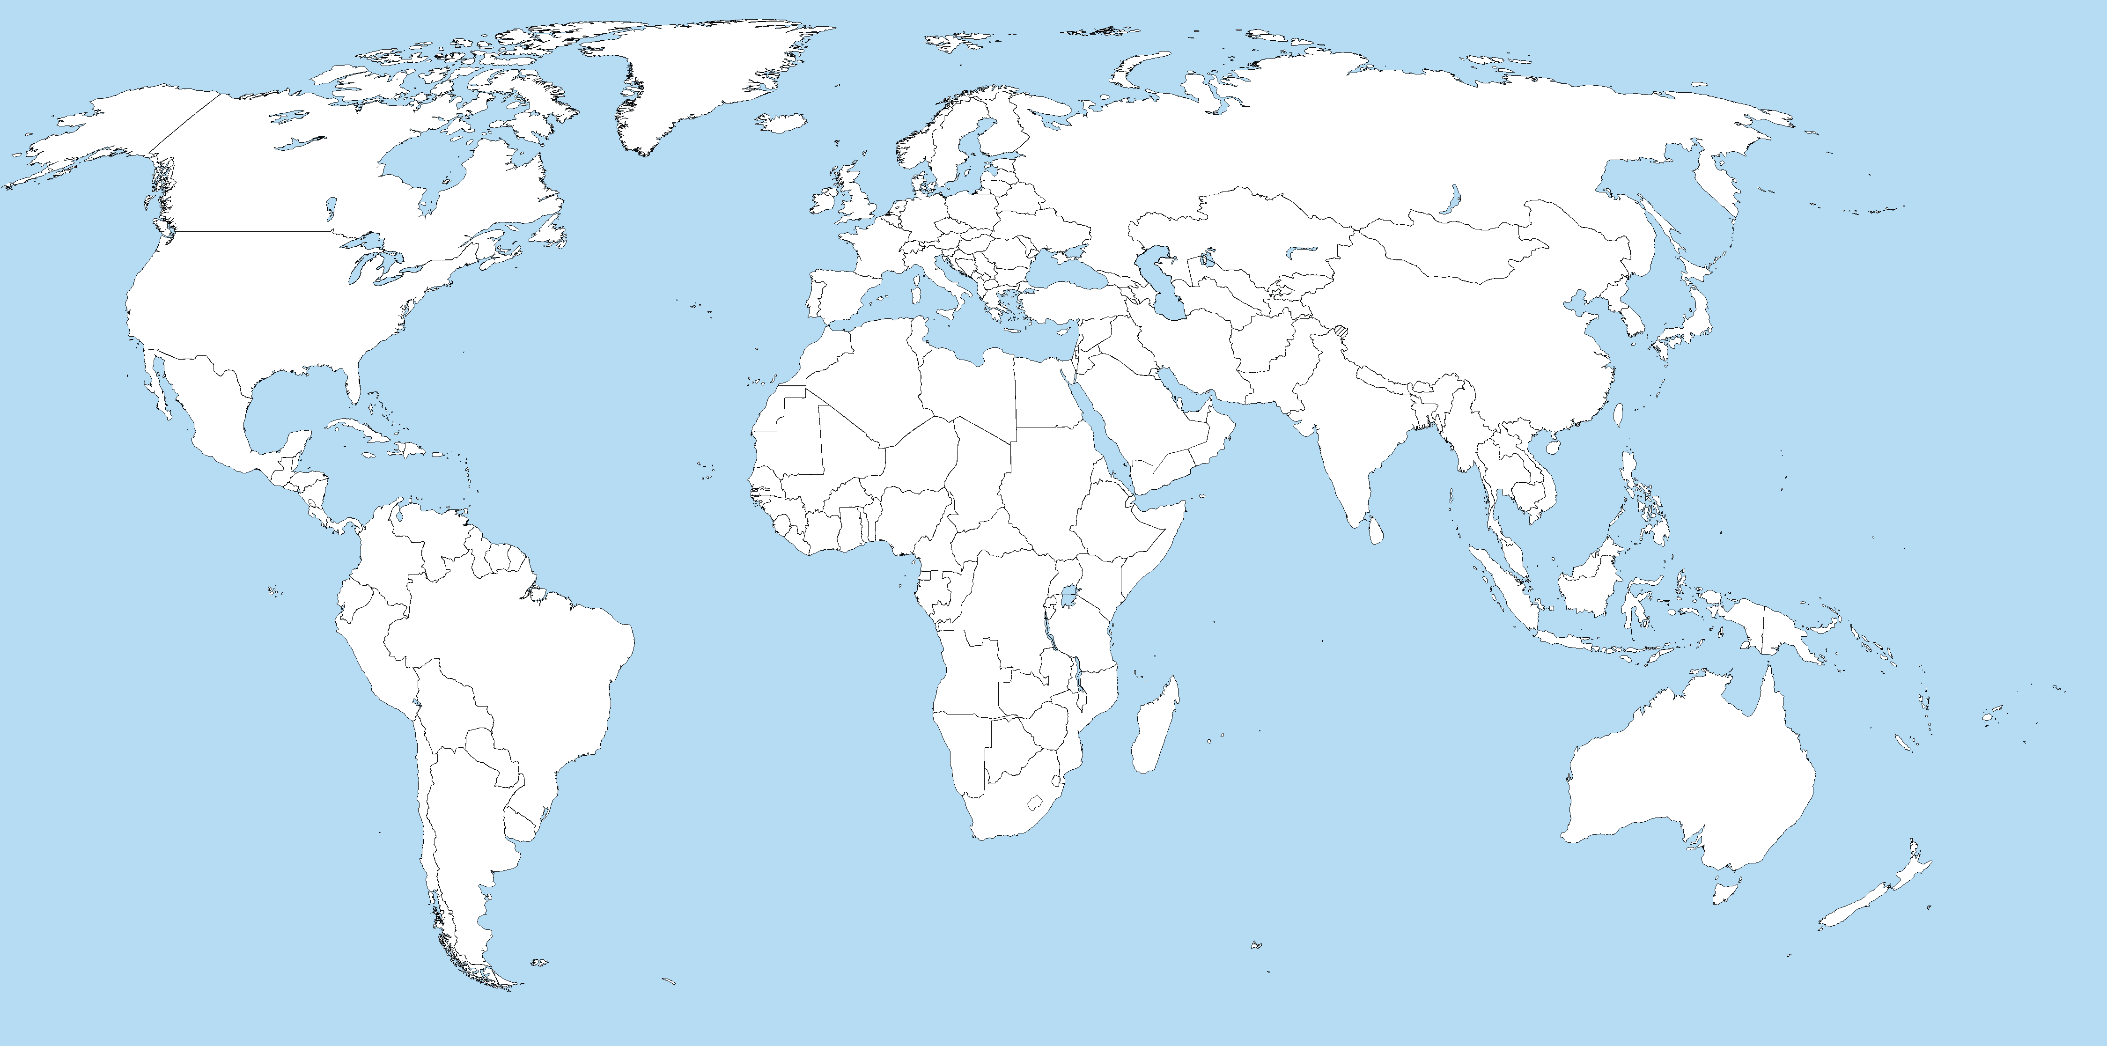
France

