Slide 1
Day 1
Aim: Introduction to Global History II
Me
You
Do Now: Talk to each other for a few minutes, catch up, don't do any work... it's the last time that will happen in here.

Slide 2
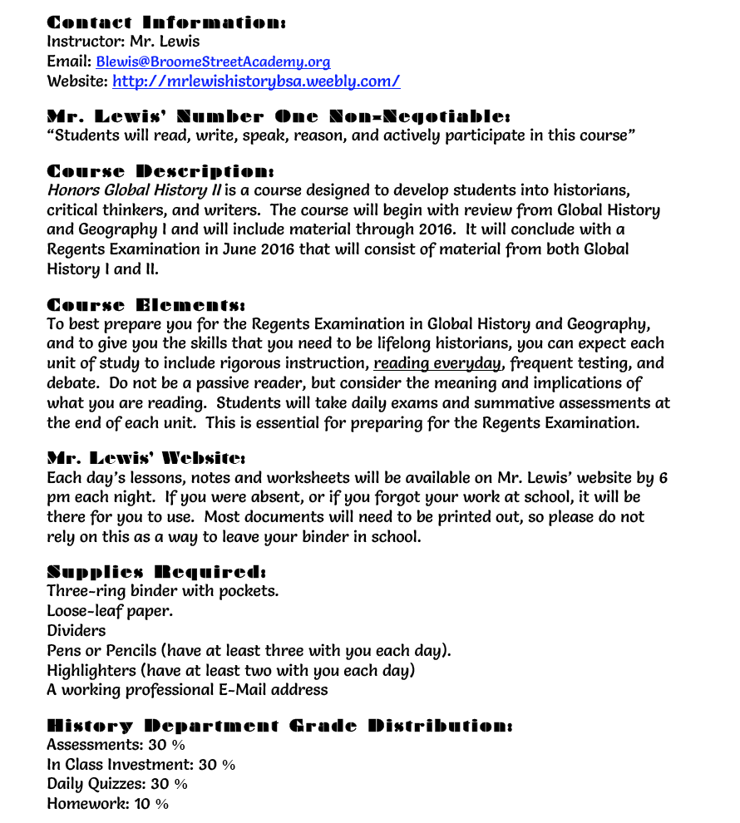

Slide 3
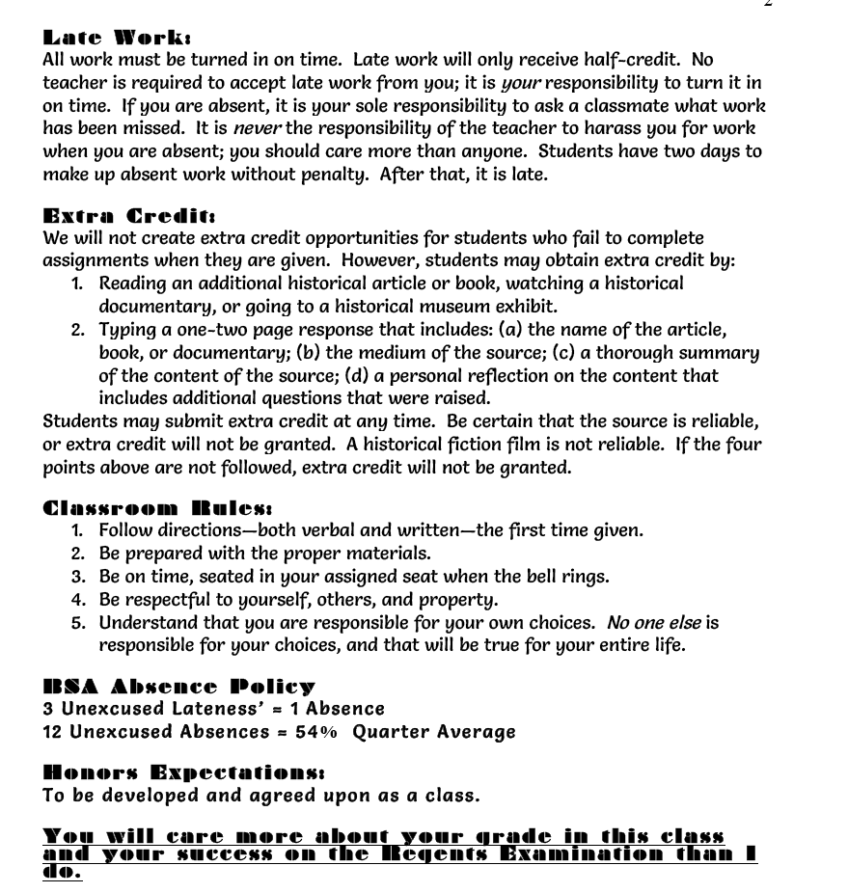

Slide 4
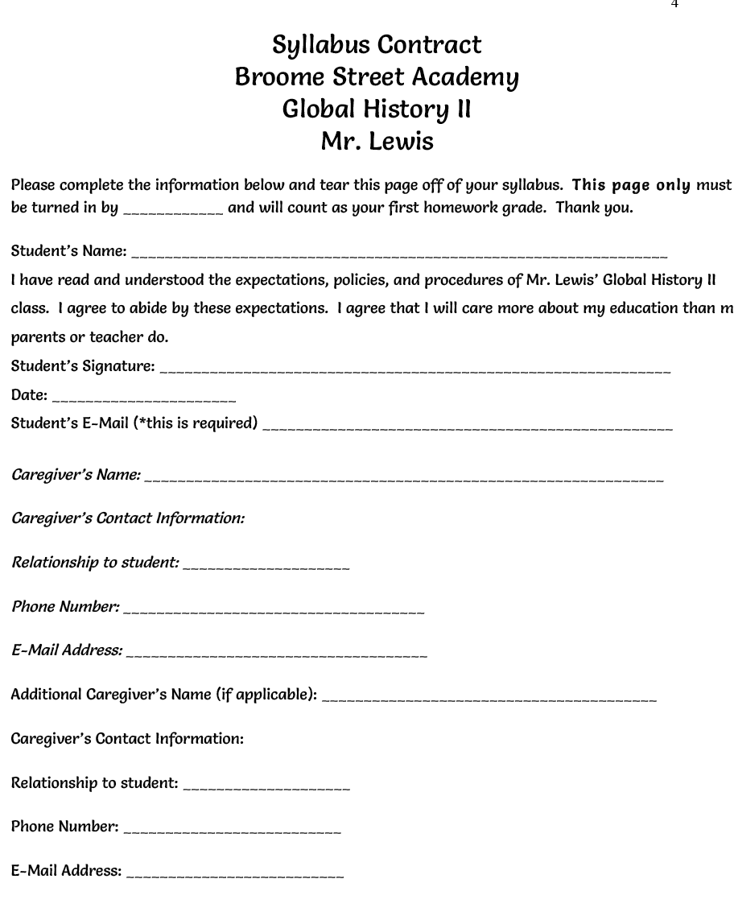

Slide 5
What is expected of "Honors" students?

Slide 6
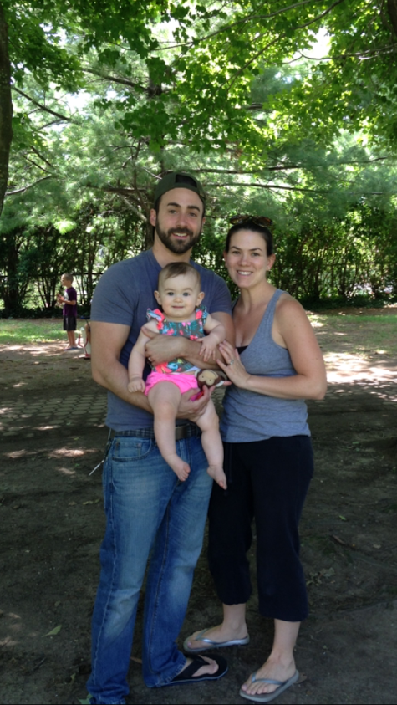
Who am I?
Father, Husband, Teacher...

Slide 7
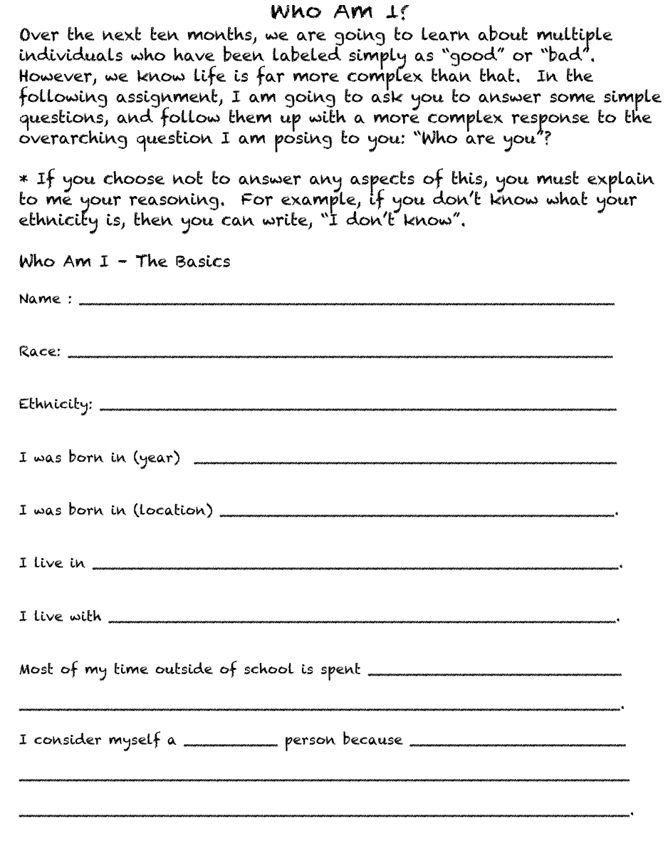
Who Are You?

Slide 8
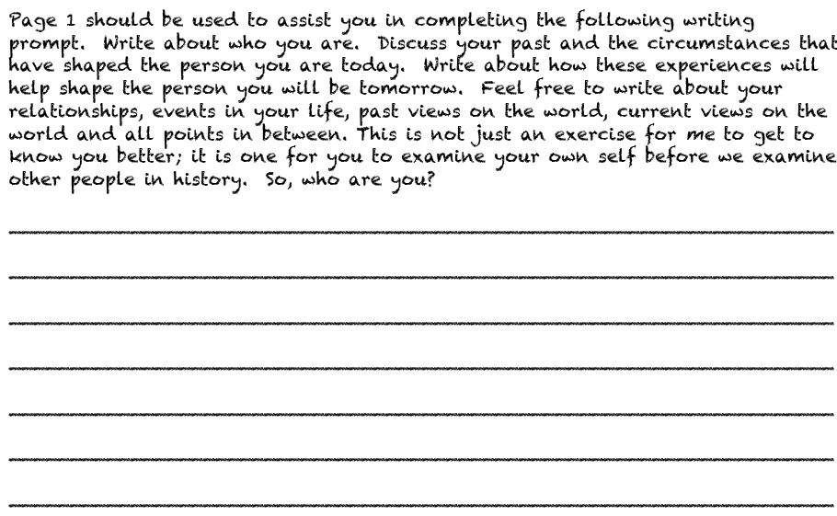

Slide 9
You have exactly one week from today to complete this assignment.

