Slide 1
Day 29
Scopo: How did Italy and Germany use nationalism to unify during the late 1800's?
Get Going: Map quiz intro!

Slide 2
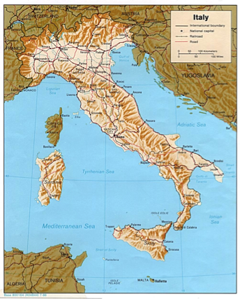
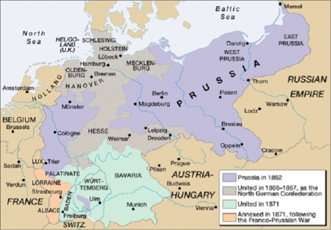
The two most famous unification movements during this time were the unification of Italy and Germany.

Slide 3
While nationalism destroyed empires, it also built nations. Italy was one of the countries to form from the territory of crumbling empires. Between 1815 and 1848, fewer and fewer Italians were content to live under foreign rulers.

Slide 4
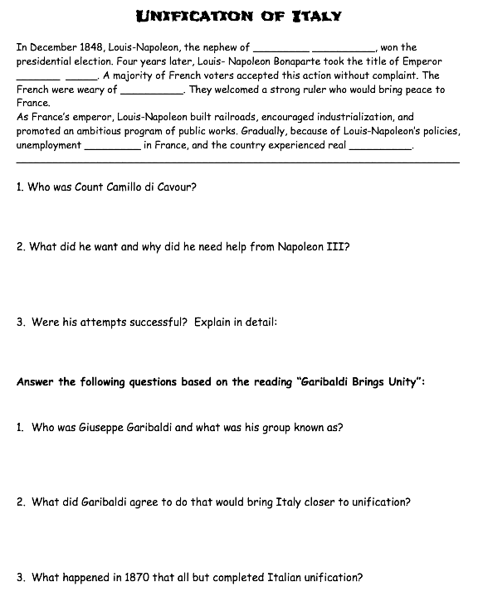

Slide 5
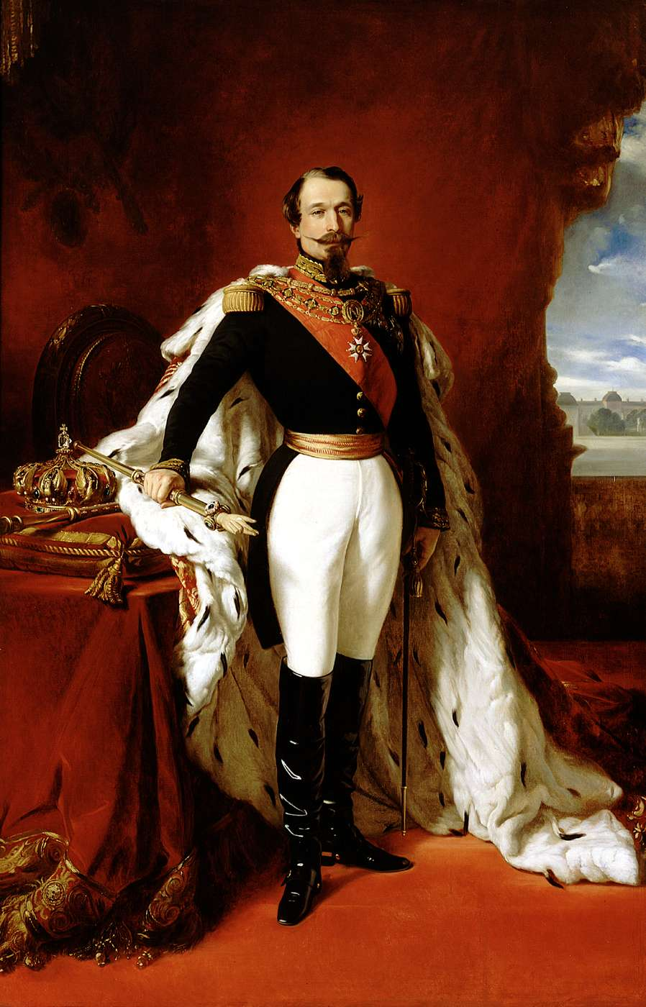
Sidebar:
In December 1848, Louis-Napoleon, the nephew of Napoleon Bonaparte, won the presidential election. Four years later, Louis- Napoleon Bonaparte took the title of Emperor Napoleon III. A majority of French voters accepted this action without complaint. The French were weary of instability. They welcomed a strong ruler who would bring peace to France.
As France’s emperor, Louis-Napoleon built railroads, encouraged industrialization, and promoted an ambitious program of public works. Gradually, because of Louis-Napoleon’s policies, unemployment decreased in France, and the country experienced real prosperity.
How does this relate to Italy? I'll tell you...

Slide 6
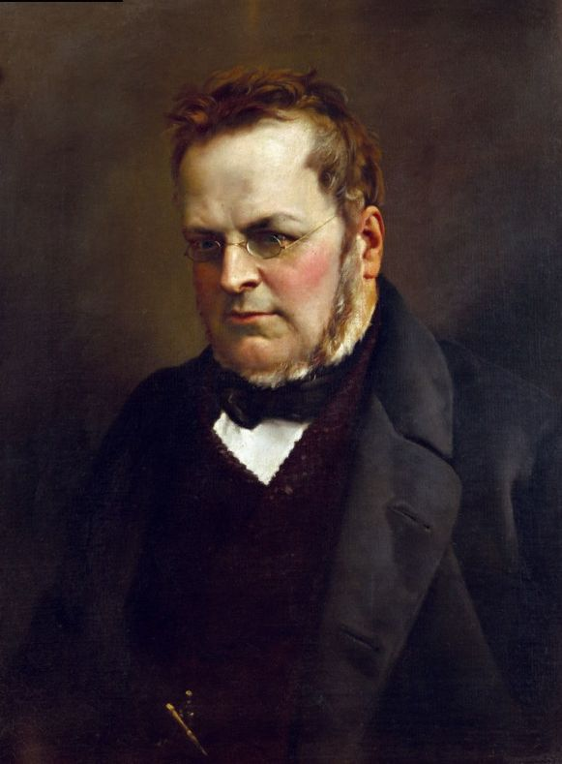
In 1852, Sardinia’s king, Victor Emmanuel II, named Count Camillo di Cavour (kuh•VOOR) as his prime minister. Cavour was a cunning statesman who worked tirelessly to expand Piedmont-Sardinia’s power. Using skillful diplomacy and well- chosen alliances he set about gaining control of northern Italy for Sardinia.
Cavour realized that the greatest roadblock to annexing northern Italy was Austria.

Slide 7
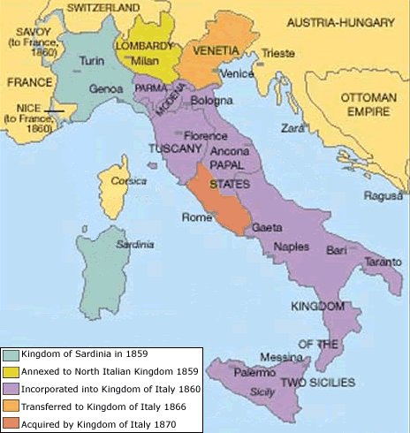

Slide 8
In 1858, the French emperor Napoleon III agreed to help drive Austria out of the northern Italian provinces. Cavour then provoked a war with the Austrians. A combined French- Sardinian army won two quick victories. Sardinia succeeded in taking of northern Italy, except Venetia.

Slide 11
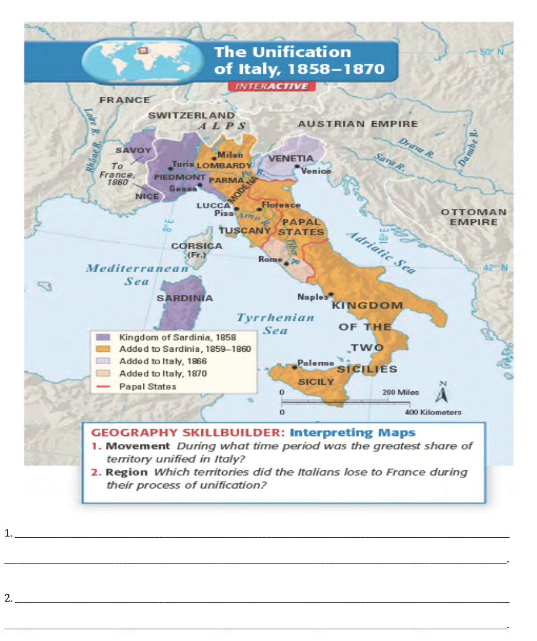

Slide 12
Like Italy, Germany consisted of many smaller states. German liberals had failed to unite their nation in the revolutions of 1848.

Slide 13
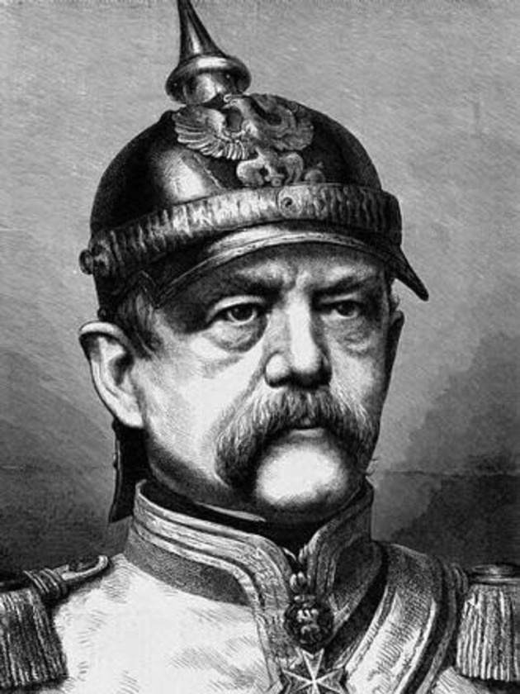
Enter... Otto Von Bismarck

Slide 14
The German Confederation was made up of about 39 different states. It was virtually the same area that was controlled by a man named _________ who was crowned Holy ______ _______ on Christmas Day by the _____. He was a very powerful man, and a leader of a group of people called the ______ who would eventually invade France and give it its name.

Slide 15
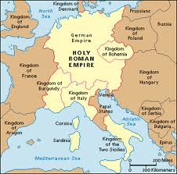
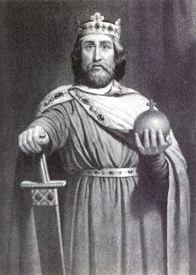

Slide 16
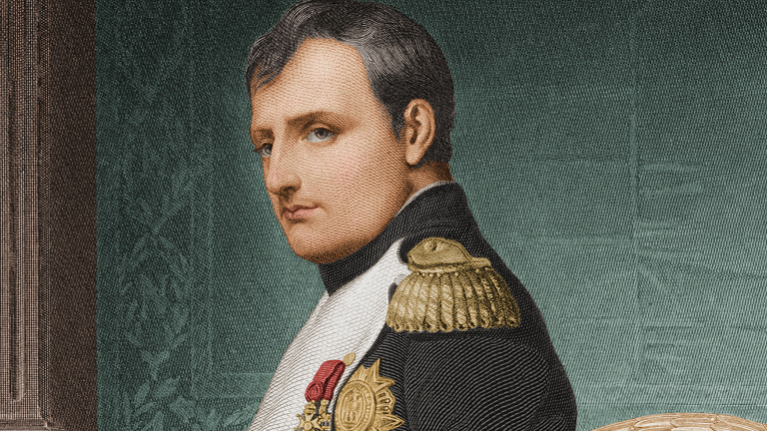
Well, you might remember a guy who conquered most of Europe and pretty much changed the political boundaries of the continent in the late 1790's- early 1800's.

Slide 17
The last Holy Roman Emperor abdicated his crown in 1804 when the French were doing their thing. After The ______ of ______ met in 1815 and cleaned everything up, the Holy Roman Empire was no more and had become the German Confederation...

Slide 18
The Austrian Empire dominated the confederation, but Prussia was ready to unify the whole thing into one Germany.

Slide 19
Why Prussia?
First of all, unlike the Austro- Hungarian Empire, Prussia had a mainly German population. As a result, nationalism actually unified Prussia.
In contrast, ethnic groups in Austria-Hungary tore the empire apart.
Moreover, Prussia’s army was by far the most powerful in central Europe. In 1848, Berlin rioters forced a constitutional convention to write up a liberal constitution for the kingdom, paving the way for unification.

Slide 20
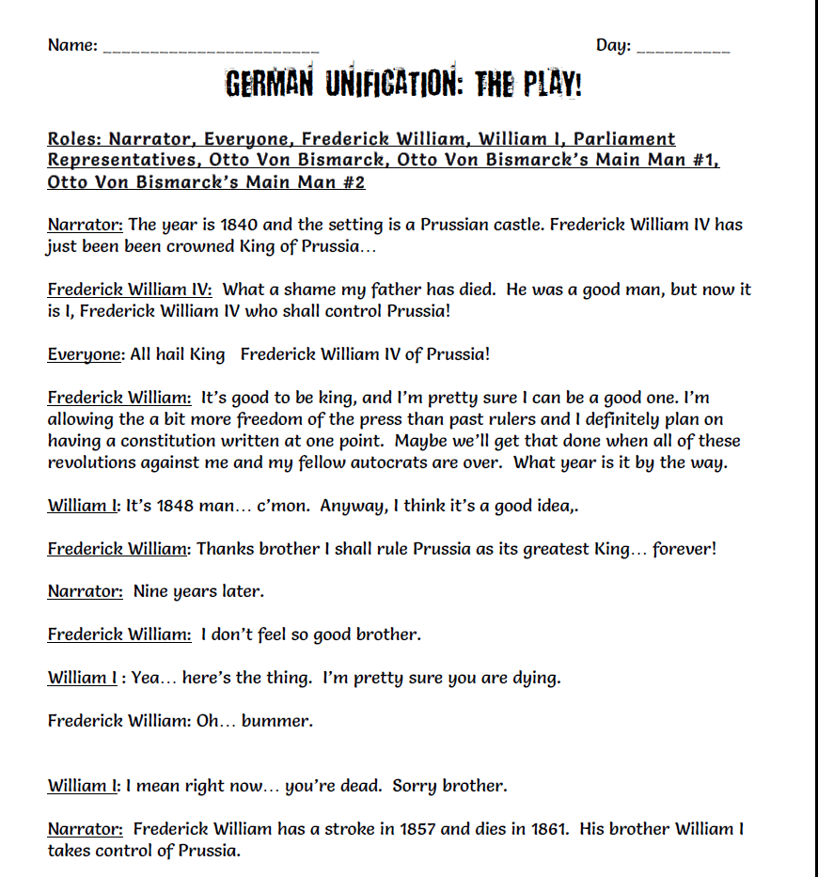

Slide 21
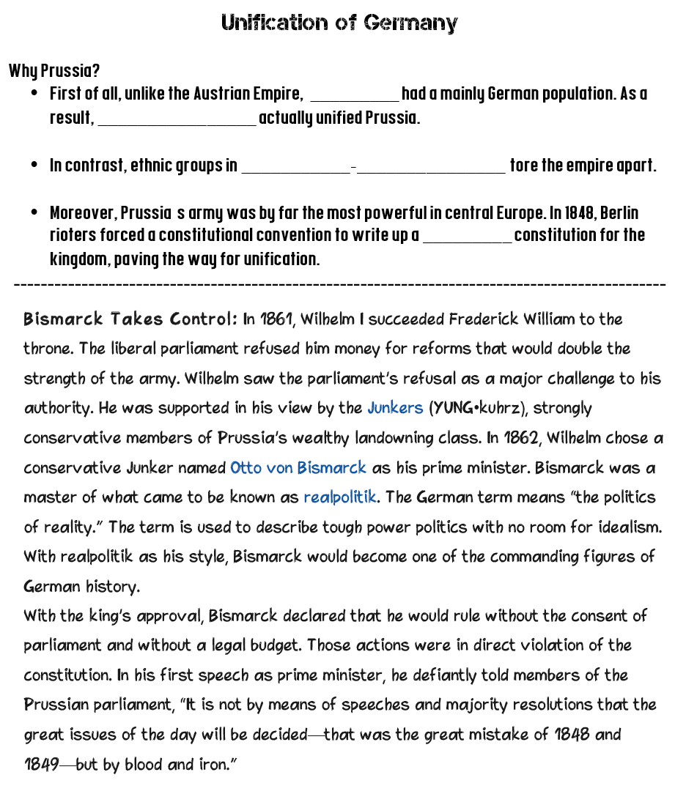

Slide 22
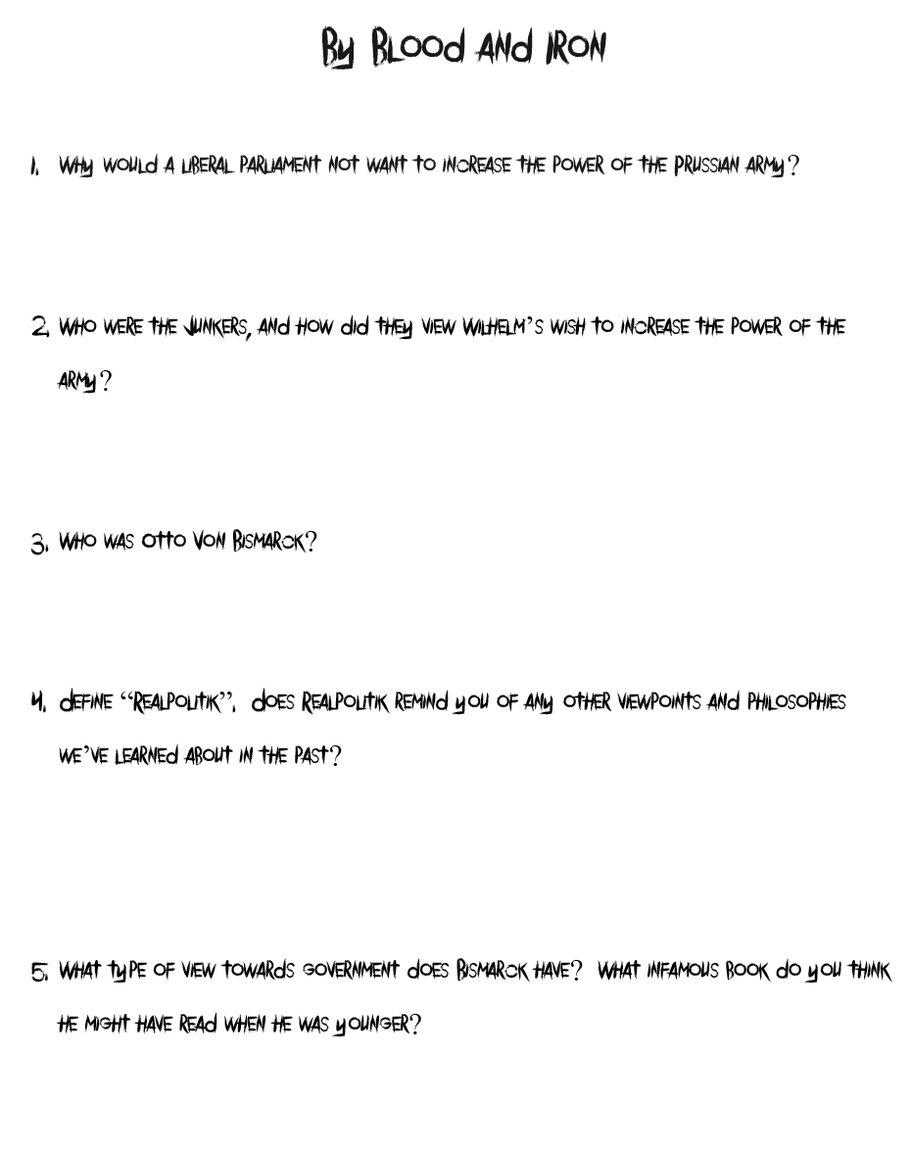

Slide 23
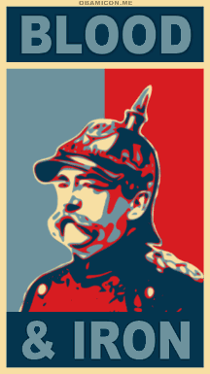

Slide 24
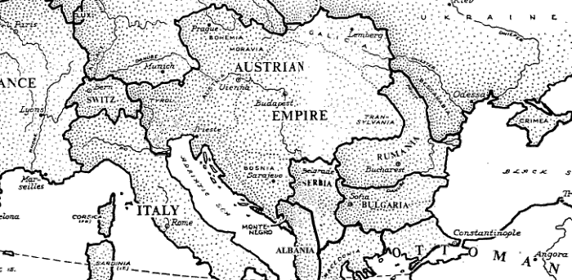
Who does Bismarck have to deal with?

Slide 25
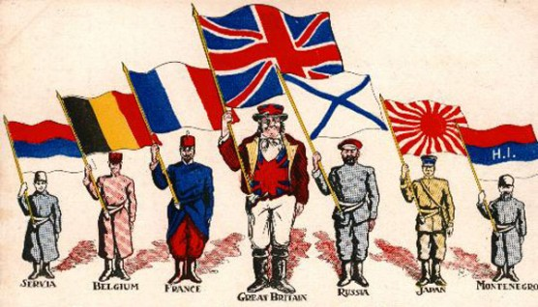
He has to get the people behind him, so what philosophy do you think he is going to use that will get people to fight and die for their "nation" of their people?

Slide 26
Write this down:
Bismarck goes to war with Denmark and wins land very quickly. Germans are proud, and feel this is the guy to unite Germany.
However, his starting trouble is going to bother ________ who will declare war on Prussia.

Slide 27
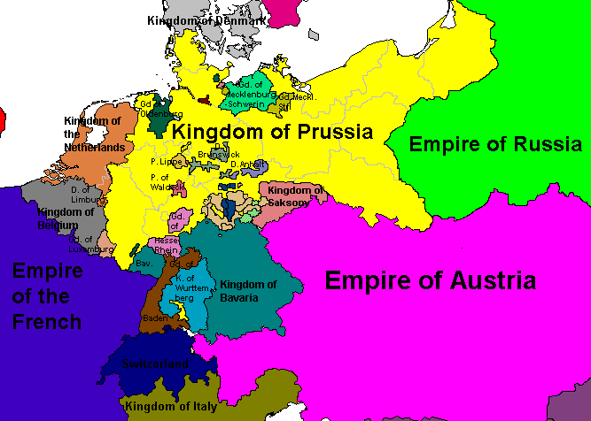

Slide 28
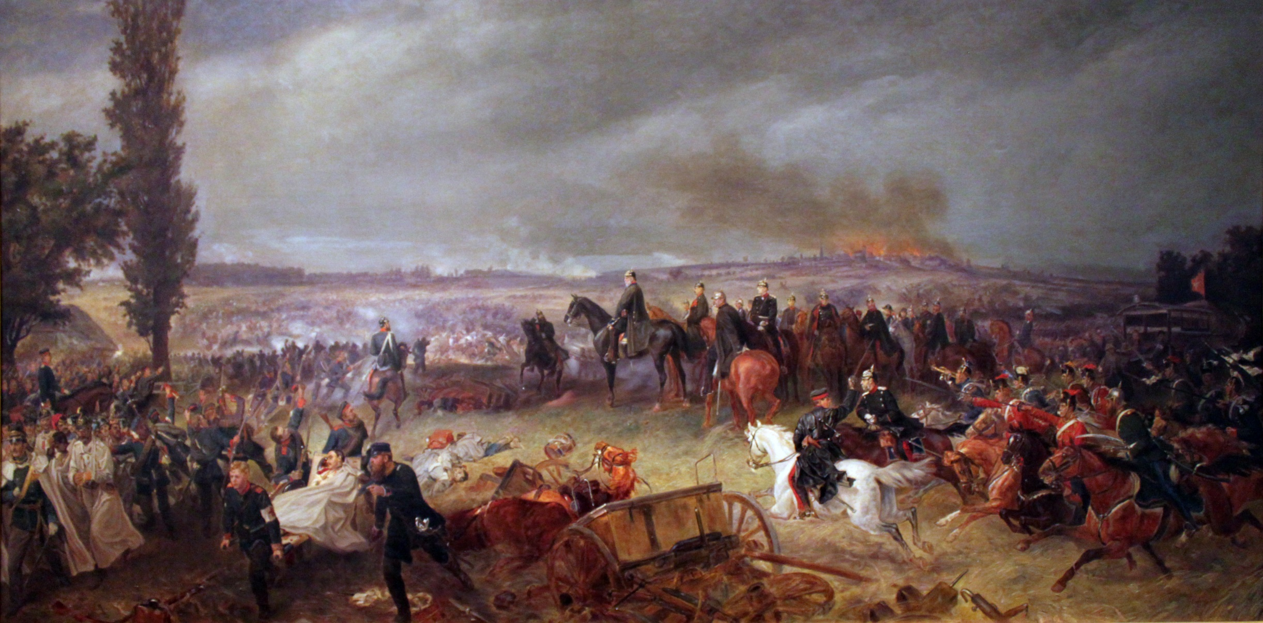
Predict: Who wins the war, and how long does it take?

Slide 29
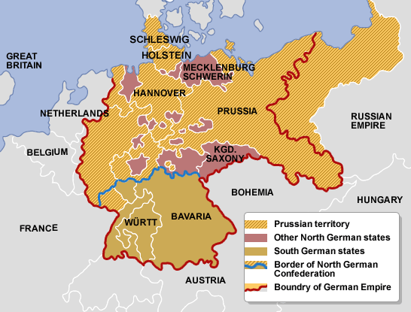
So Prussia defeats Austria in what is known as the Seven Weeks' War. Austria is humiliated, and Prussia takes control of northern Germany.

Slide 30
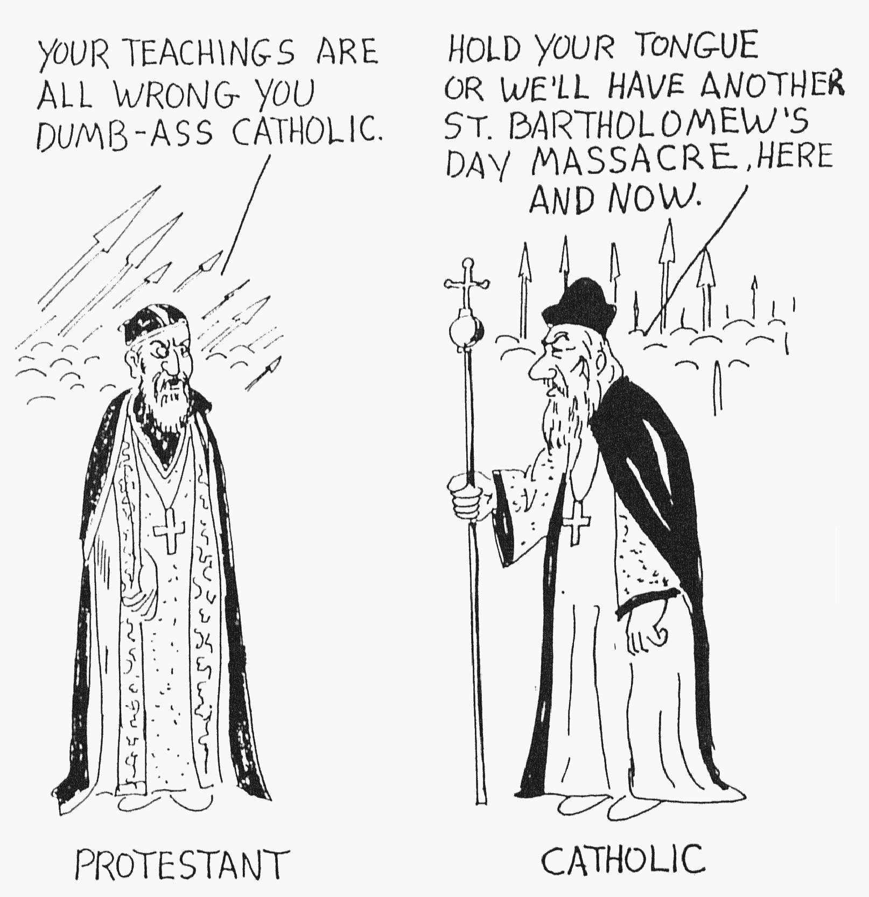
Bismarck is not done, he wants everyone to join... otherwise its not true unification. So he has to get these southern Germans to join him. He can't force them, because we know what that would eventually lead to. Plus, there's a religious issue here to.
Southern German states
Prussia
vs

Slide 31
Bismarcks Plan?
To use nationalism as a ploy to unite all of the German states against another country. So he picks a fight with...

Slide 32
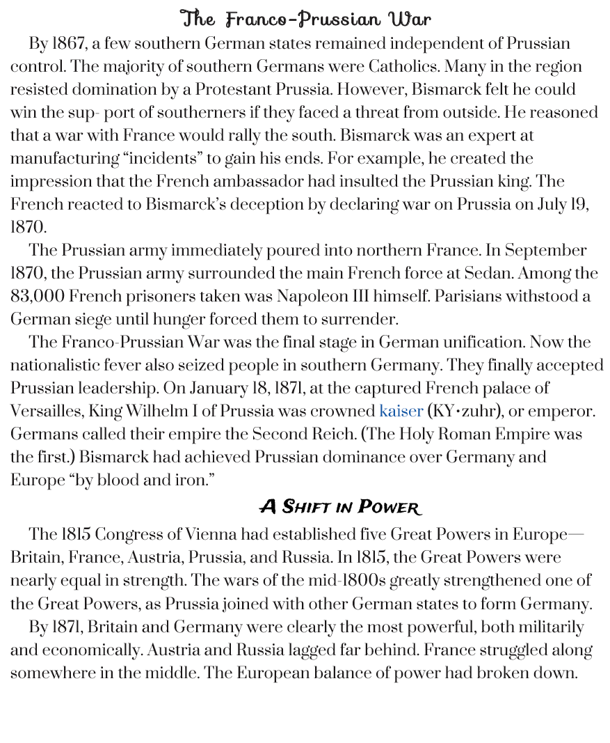
Franco-Prussian War

Slide 33
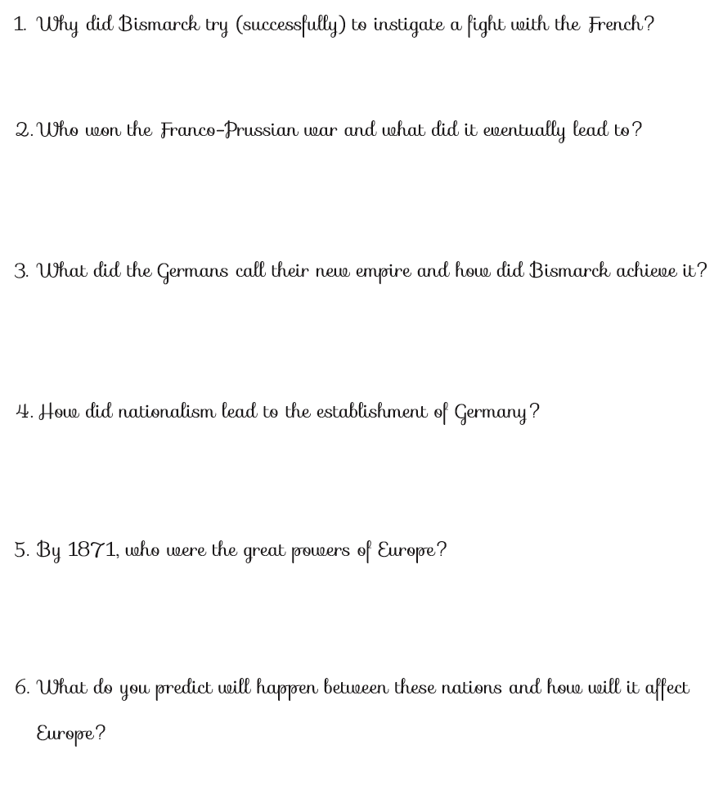

Slide 34
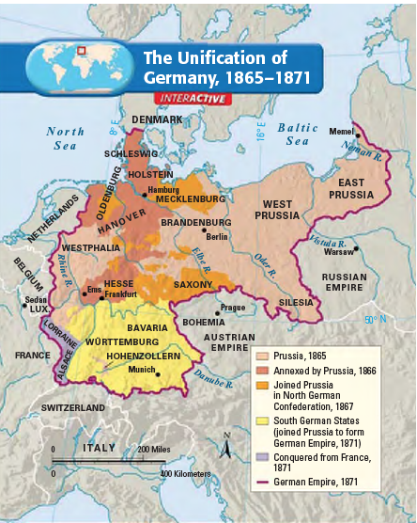

Slide 35
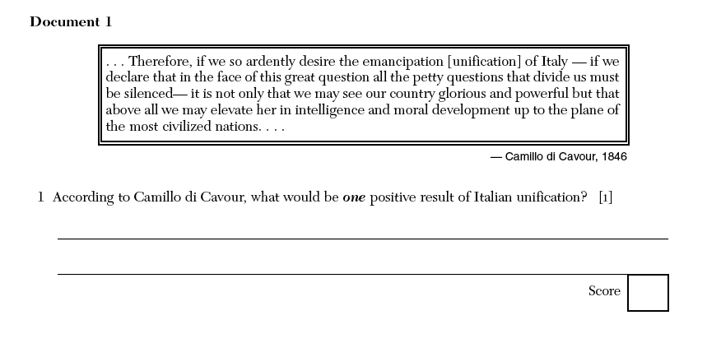

Slide 36
