Slide 1
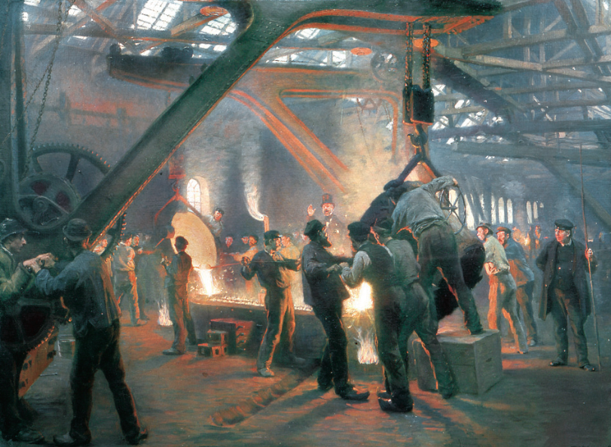
Quaestio: Why were capitalism and socialism both appealing ideologies for different sectors of society?
Nunc Agenda: Complete the remaining questions on your “Growing and Changing Industrial World” reading and prepare to discuss it.

Slide 2
It Began With Coal and Capital
Factors of Production = Land (resources) Labor (workers) Capital (money)
Abundant in Britain, coal began to be used as a cheap fuel to replace wood
The Steam Engine was developed to pump water out of flooded mines, but once improved by James Watt in 1765, it became the new way of generating power, and it ran on coal. Iron, also plentiful in Britain, was required to build the machine, as well as many more that would come.

Slide 3
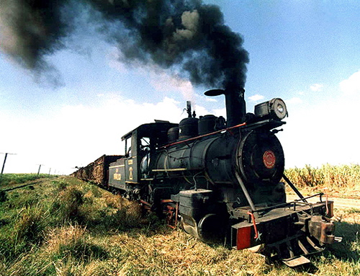
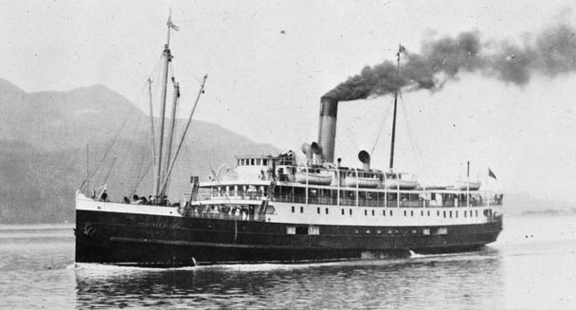
It Began With Coal and Capital
Steam power went on to power factory machinery, steam-powered trains (Richard Trevithick, 1802), and steamships (Robert Fulton, 1807)
However, Britain also had abundance of capital, or money for investment, thanks to mercantile wealth generated from exploiting its colonial possessions
By the mid-1800s, other nations were industrializing, especially Germany and the USA

Slide 4
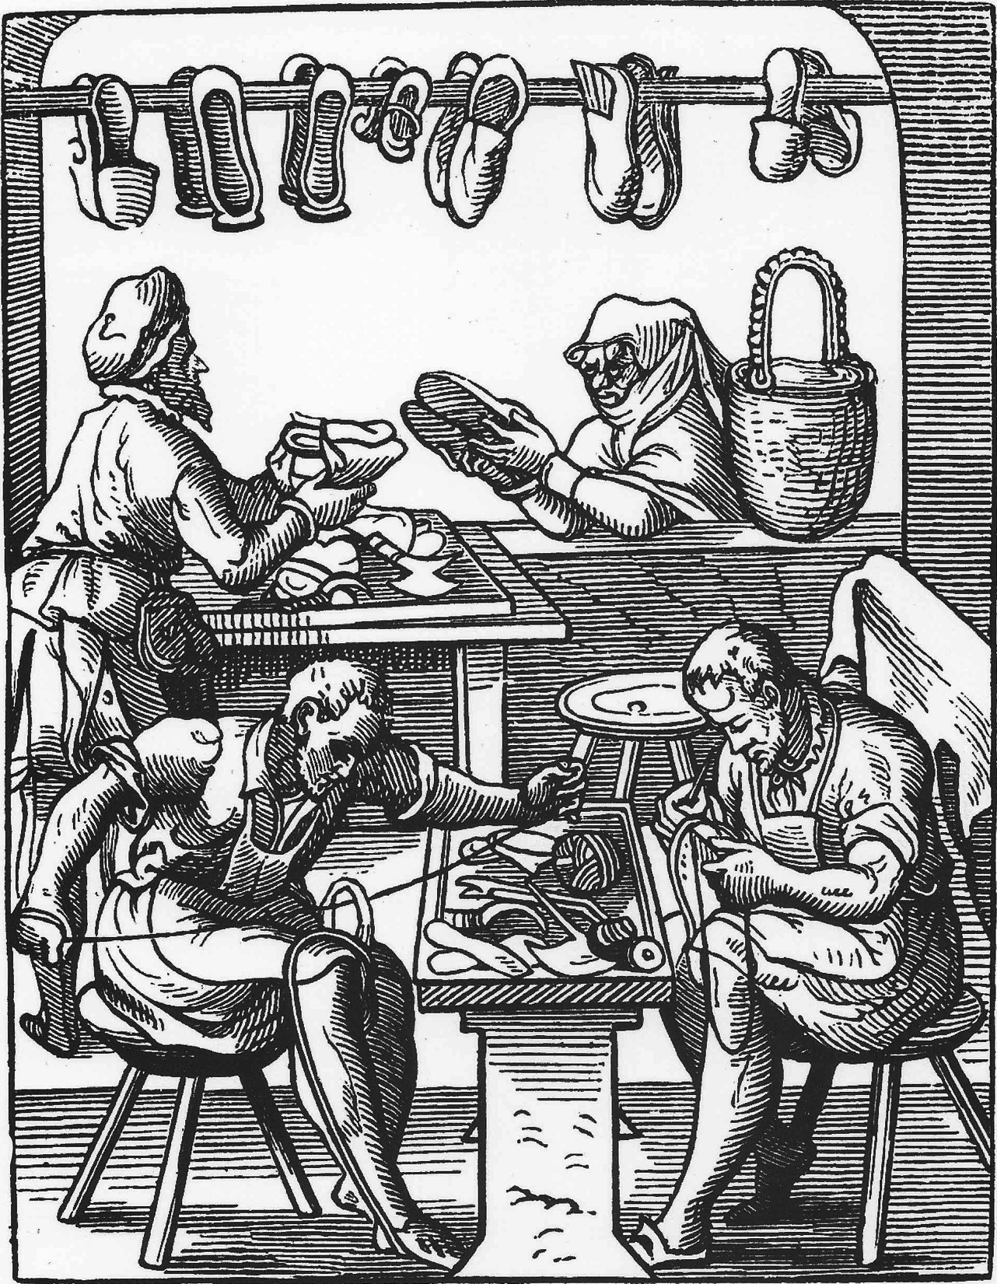
Changes to Labor Disrupt Society
Industrialization led to Urbanization, or the growth of cities, due to peasant farmers leaving their land and moving to cities to work in factories and coal mines
Traditional economic institutions like craft guilds, which trained artisans to produce specialized goods, and cottage industries, which employed peasants to produce textiles at home, became obsolete (outdated, useless), unable to compete with the productivity of factories

Slide 5
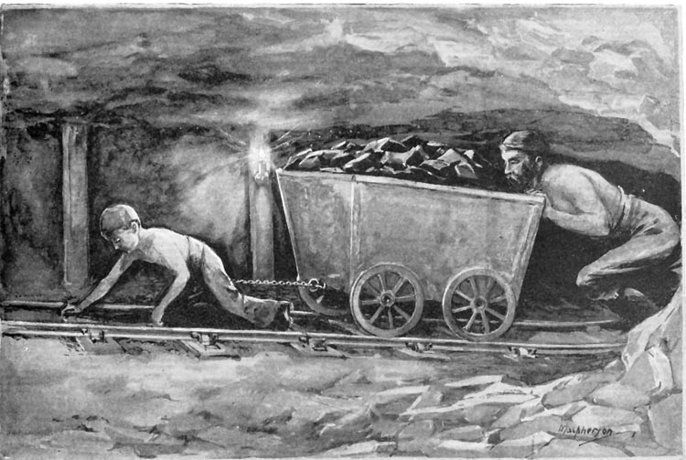
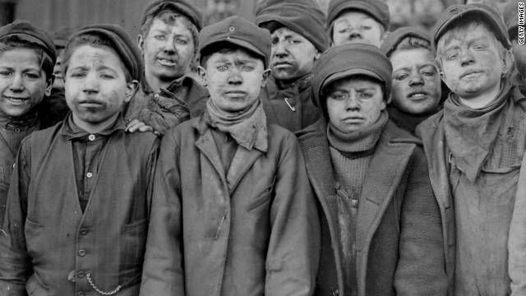
Changes to Labor Disrupt Society
Working conditions in factories were dangerous and exploitative, requiring long hours for little pay
Mine workers had even worse conditions
worked in darkness with coal dust in their lungs
faced dangers of flooding, collapse, or explosion
young children hauled coal carts strapped to their waists causing permanent deformities

Slide 6
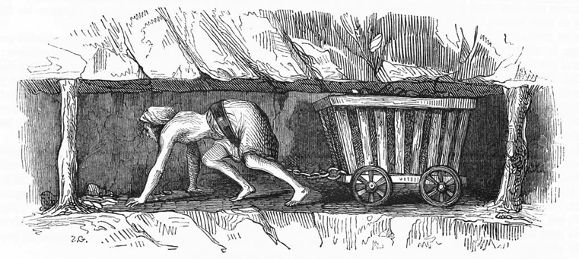

Slide 7
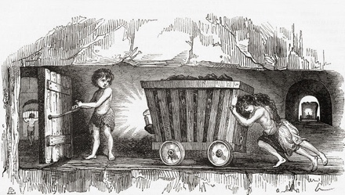

Slide 8
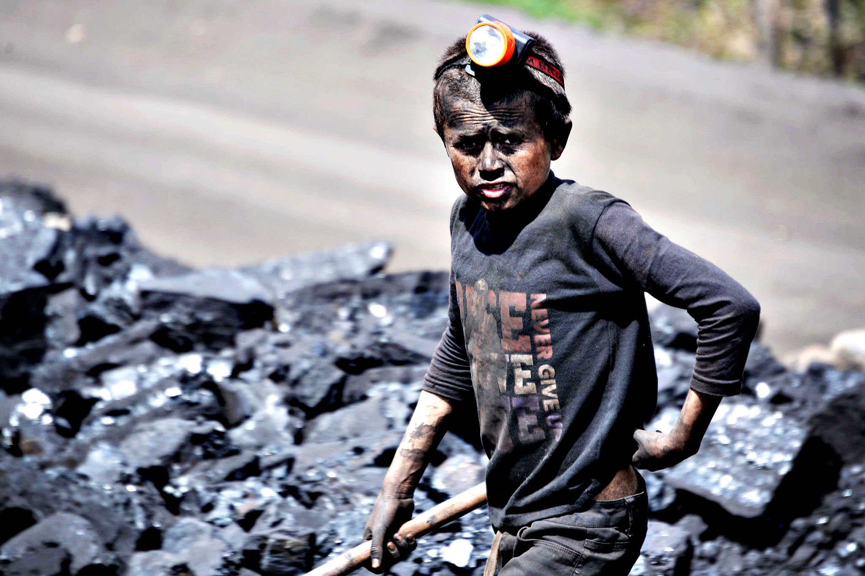

Slide 9
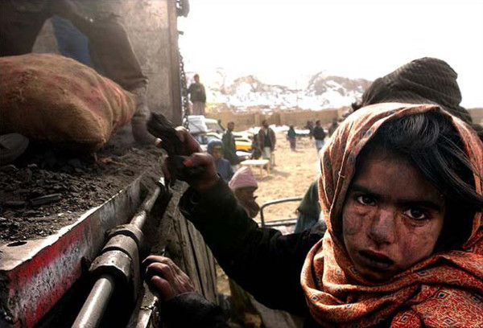

Slide 10
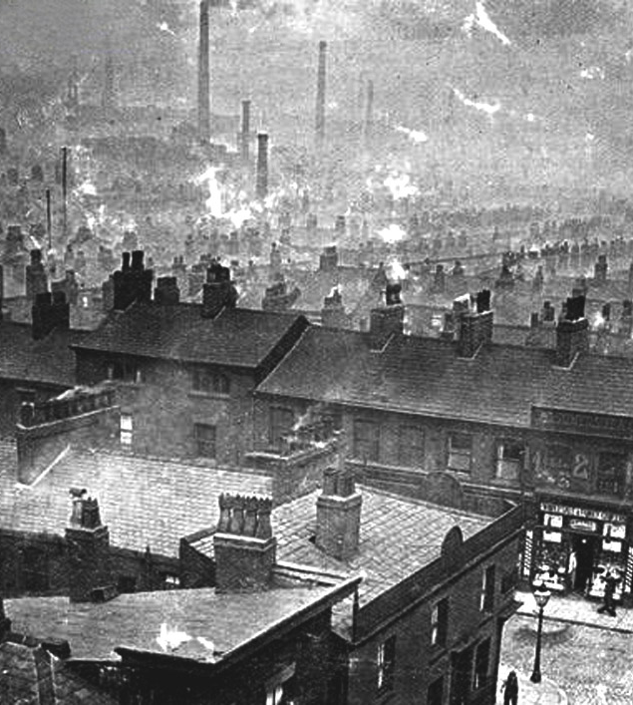
Changes to Labor Disrupt Society
Living conditions in rapidly growing unplanned cities were literally out of control
Slums, overcrowded and dirty areas of cities, became homes to the poor and jobless
Many lived in one-room tenements, poorly constructed apartments without running water or sewage systems
Pollution from factories and mines as well as from garbage and human waste contaminated rivers and spread disease

Slide 12
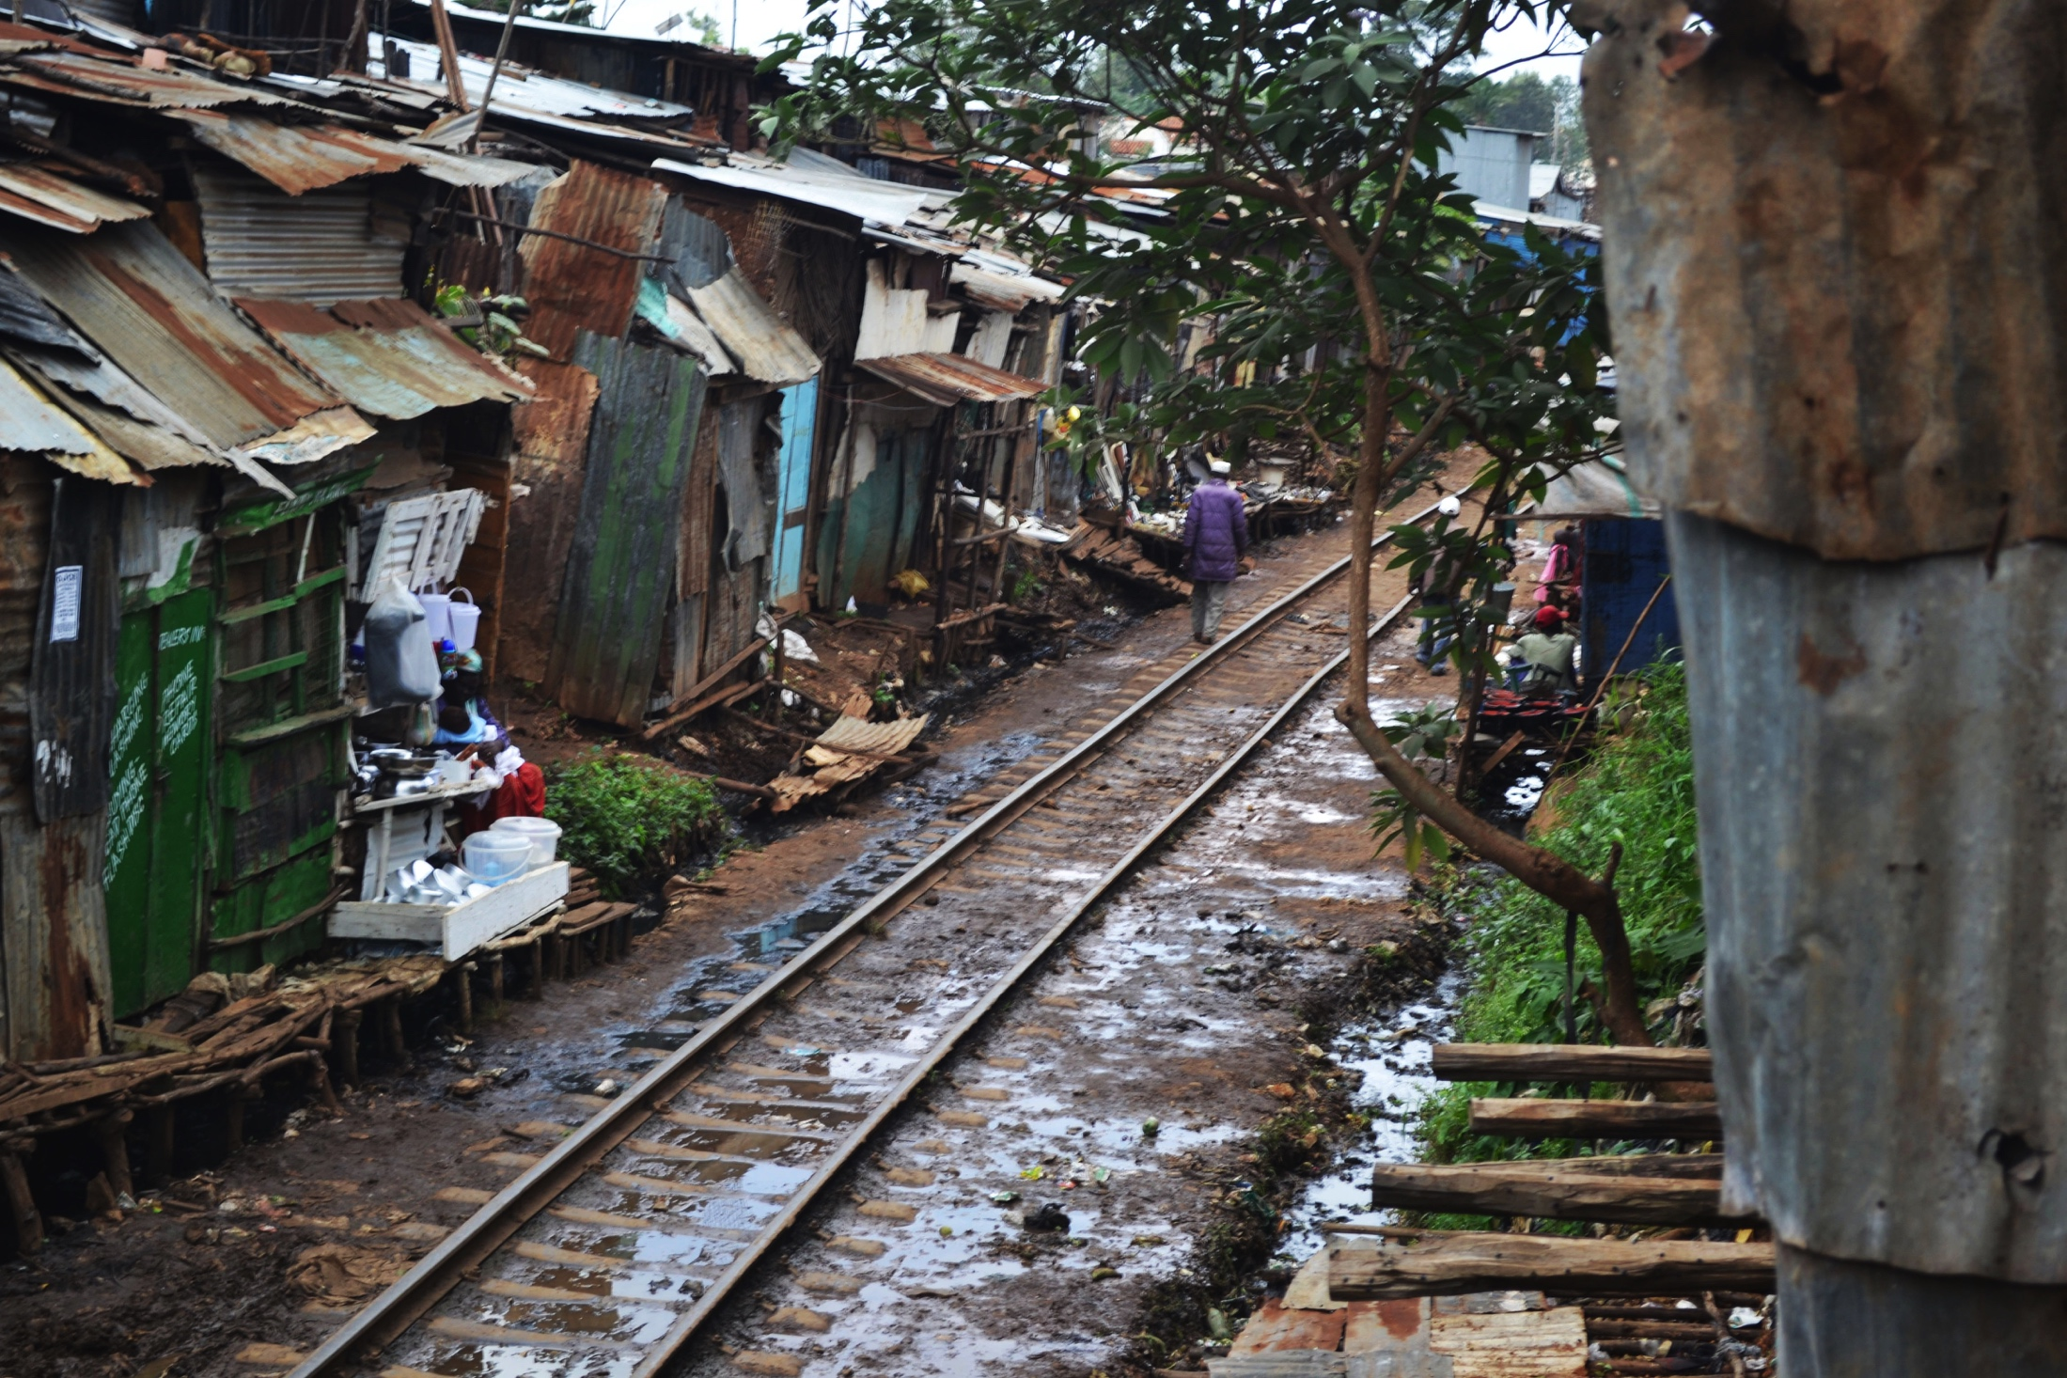

Slide 13
The Appeal of Capitalism
Capitalism: Economic philosophy developed in the enlightenment to challenge mercantilism
Instead of high tariffs to encourage export over import, Capitalists believed free trade was best
Adam Smith: Father of Capitalism, wrote in The Wealth of Nations about the “natural laws” of economics, which should be left alone to work naturally as the “invisible hand” of the market

Slide 14
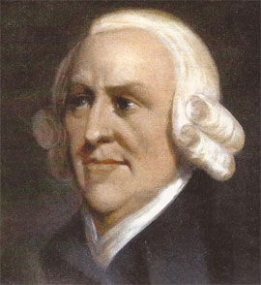
The Appeal of Capitalism
the law of self-interest: People work for their own good.
the law of competition: Competition forces people to make a better product.
the law of supply and demand: Enough supply of goods would be produced at the lowest possible price to meet demand in a market economy.
In other words, if producers had to compete against each other for business, they would have to keep quality high and prices low, which benefitted the consumer

Slide 15
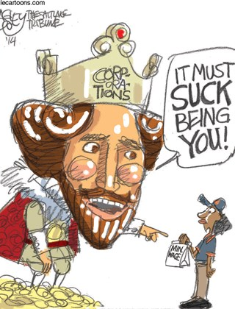
The Appeal of Socialism
The “Laissez Faire” (Let It Be) approach of Free Market Capitalism predicted benefit for the producer and the consumer, but failed to consider the worker who was exploited by the producer
Pay low wages to keep prices low
Demand longer hours to increase production
Oppose labor organization and regulation to protect profits

Slide 16
The Appeal of Socialism
Socialism denounced Capitalism for creating such conditions, and insisted on change
Emphasized equality and cooperation instead of dominance and exploitation
Believed that the factors of production should be owned collectively by the public
Thought that the government should control the economy rather than the invisible hand
Advocated extending the right to vote to more people in society
Moderate Socialists called for reform, Communists called for revolution

